Slide 1
Behavioral Medicine
Why is it so important?

Slide 2
Overview
Statistics
Behavioral problems clients expect you to know.
Behavioral problems you should be able to
properly refer.
Safety
Behavioral modification as a part of your medical treatment.
Reasons to include behavior in your clinic.
How do I learn more about behavior?
Resources

Slide 3
Feline Statistics
28% of cats are relinquished to shelters because of behavioral problems
4-9 million cats die each year in shelters.
18-33% die due to behavioral problems in shelters.
Top 4 Behavioral Problems:
House soiling
Problems between pets
Aggression towards humans
Destructive behaviors
Bonnie Beaver, “Feline Behavior: A Guide for Veterinarians”

Slide 4
Canine Statistics
Aggression is the most commonly reported behavioral problem in dogs.
1-3 million people in the United States are bitten by dogs each year.
Children are bitten more than adults.
More than half a million of these bites result in serious injury.
Linda Case, “The Dog Its Behavior, Nutrition & Health”

Slide 5
Clients expect you to know:
Everything!!!!!!!

Slide 6
What you should really know:
Canine
Basic behavior
Proper handling
House training
Crate training
Puppy biting
Jumping
Destructive behaviors
Proper socialization
Proper introduction
Separation anxiety
Barking
Importance of mental stimulation
Dogs and children

Slide 7
What you should really know:
Feline
Basic behavior
Proper handling
Litter box training and prevention
Kitten biting and clawing
Destructive behaviors
Jumping on Countertops
Proper socialization
Proper introduction
Petting aggression
Predatory aggression
Importance of mental stimulation
Separation Anxiety
Cats and children

Slide 8
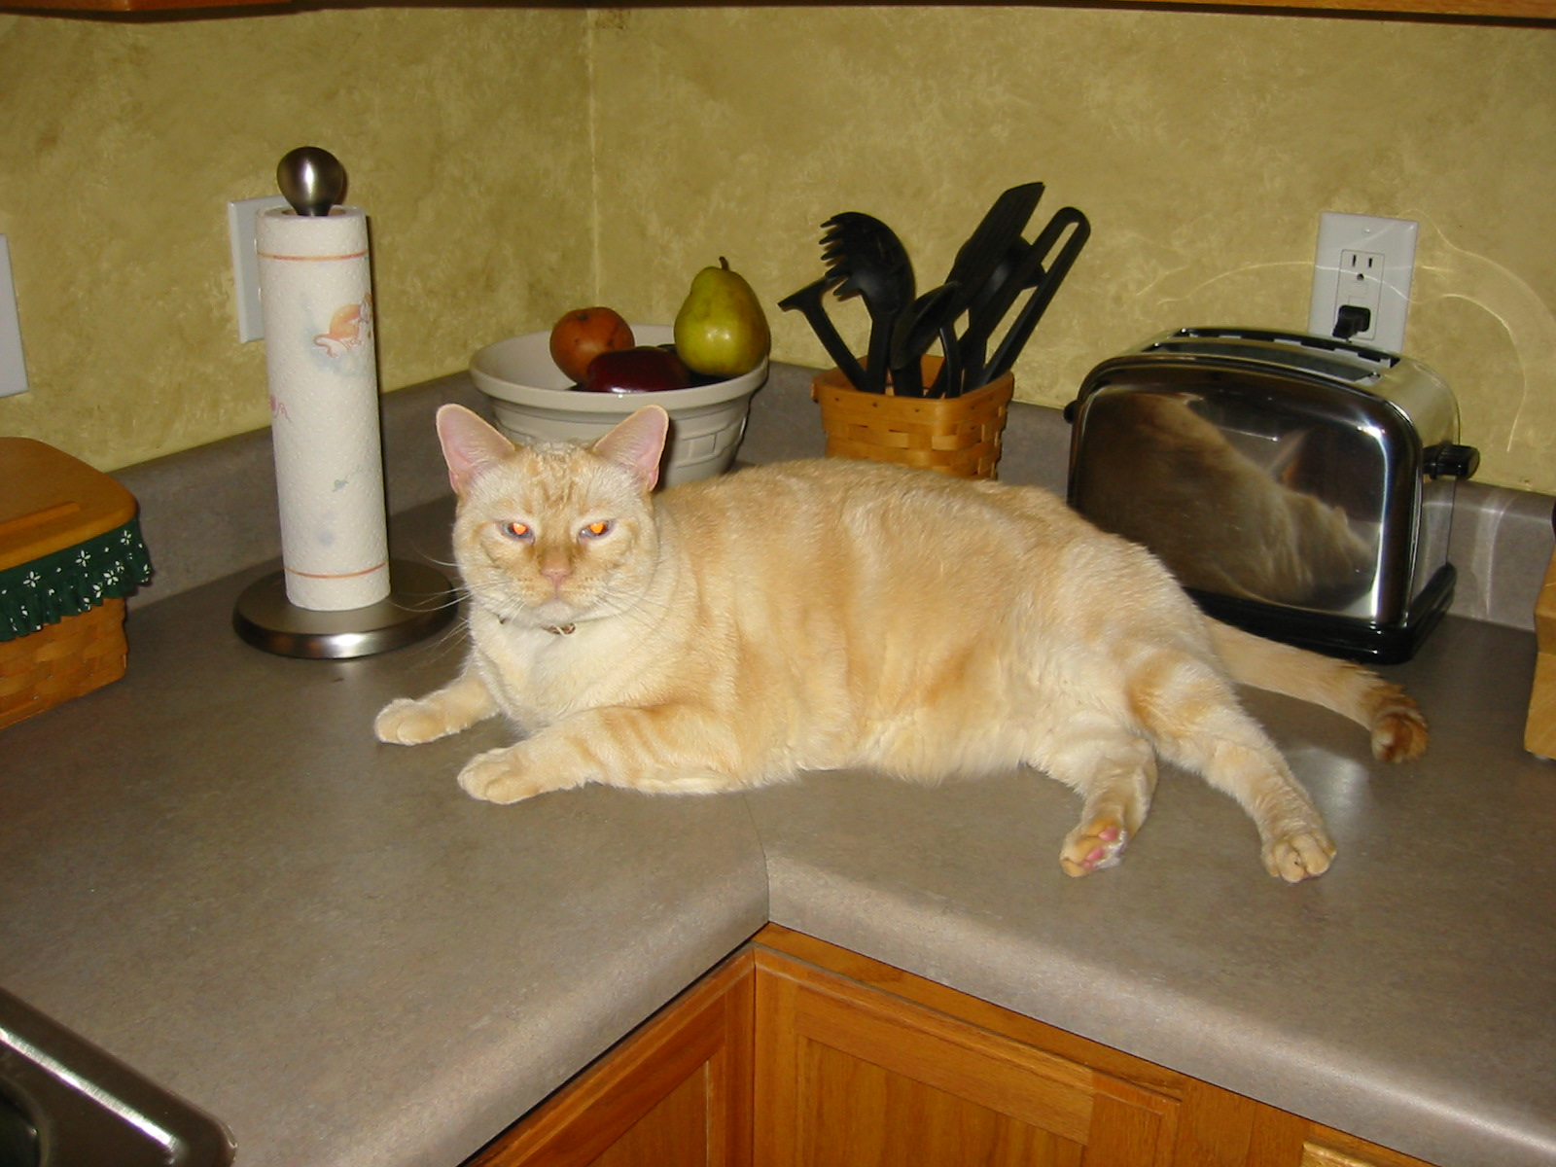
Bad Kitty?

Slide 9
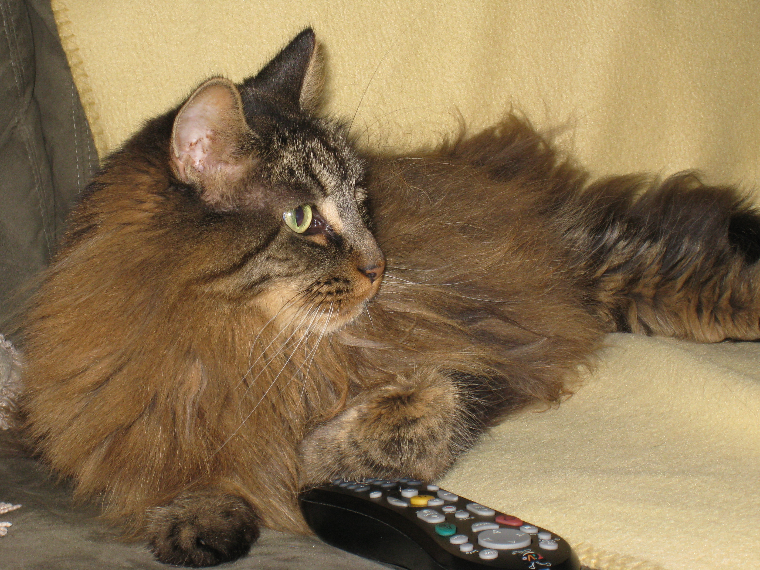
What you should refer:
Aggression
Separation Anxiety
Suggestions not working
Suspect more going on
Unusual situation
Time commitment
Children involved
Pharmacotherapy

Slide 10
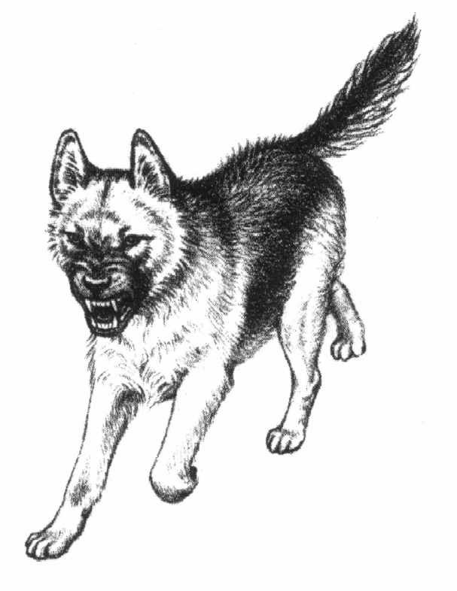
Your safety at work

Slide 11
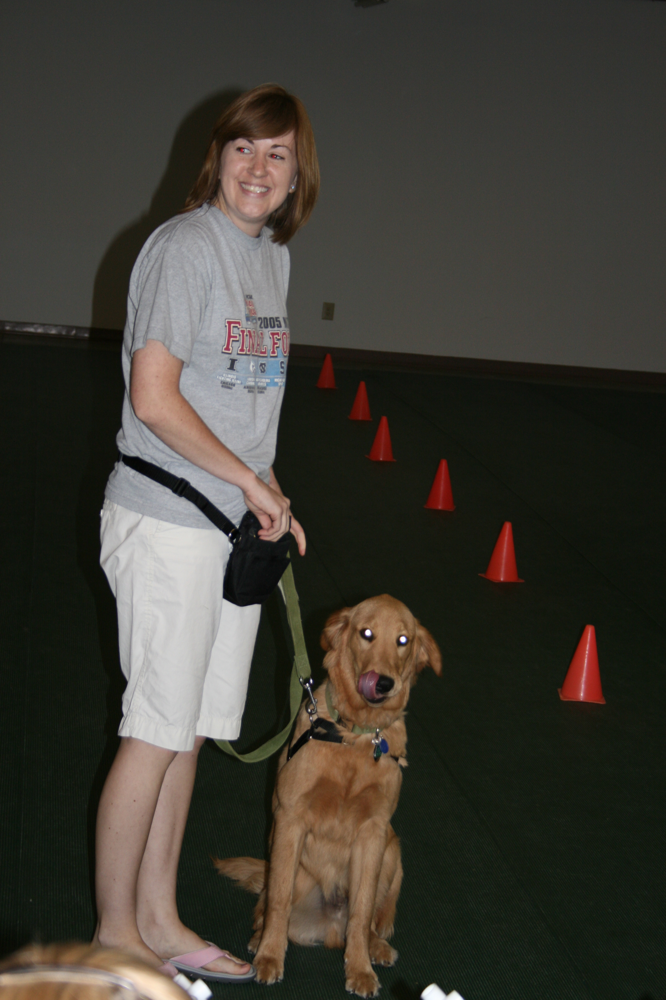
Subtle Signs
Who is really happy here?
Tongue flick or out
Ears back
Dilated pupils or squinty eyes
Whale eye
Muscle contraction
Mouth almost shut
Watch for changes in behavior

Slide 12
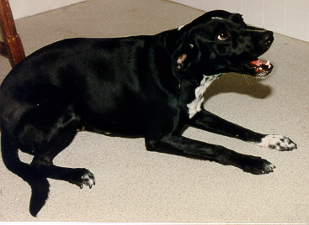

Slide 13
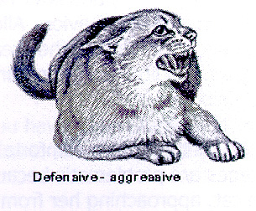
How about cats?
Any question about this cat?

Slide 14
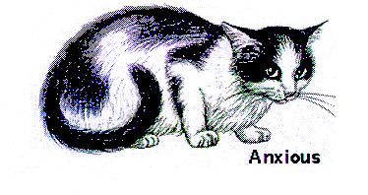
Subtle Signs
Ears back
Dilated pupils
Whiskers taught
Muscle contraction
On all 4 paws
Low

Slide 15
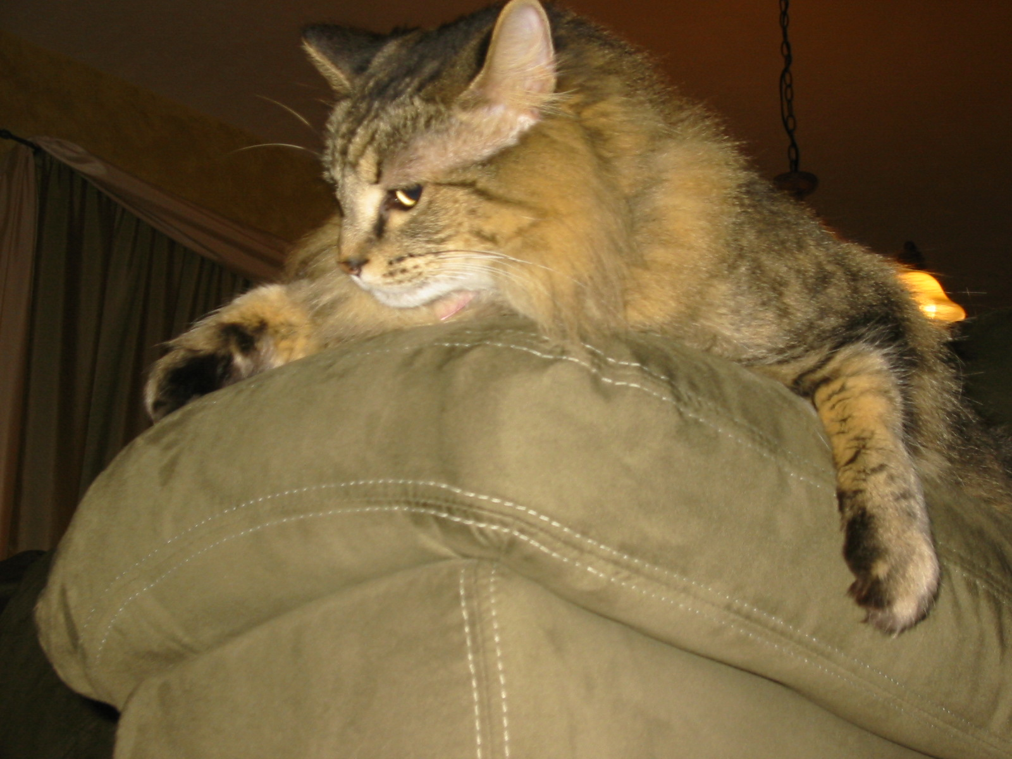

Slide 16
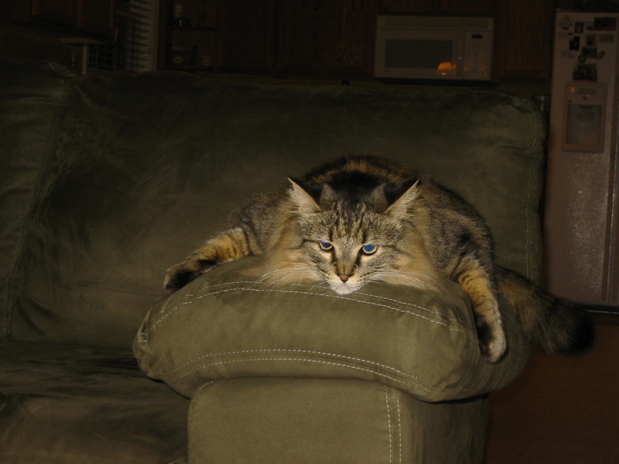

Slide 17
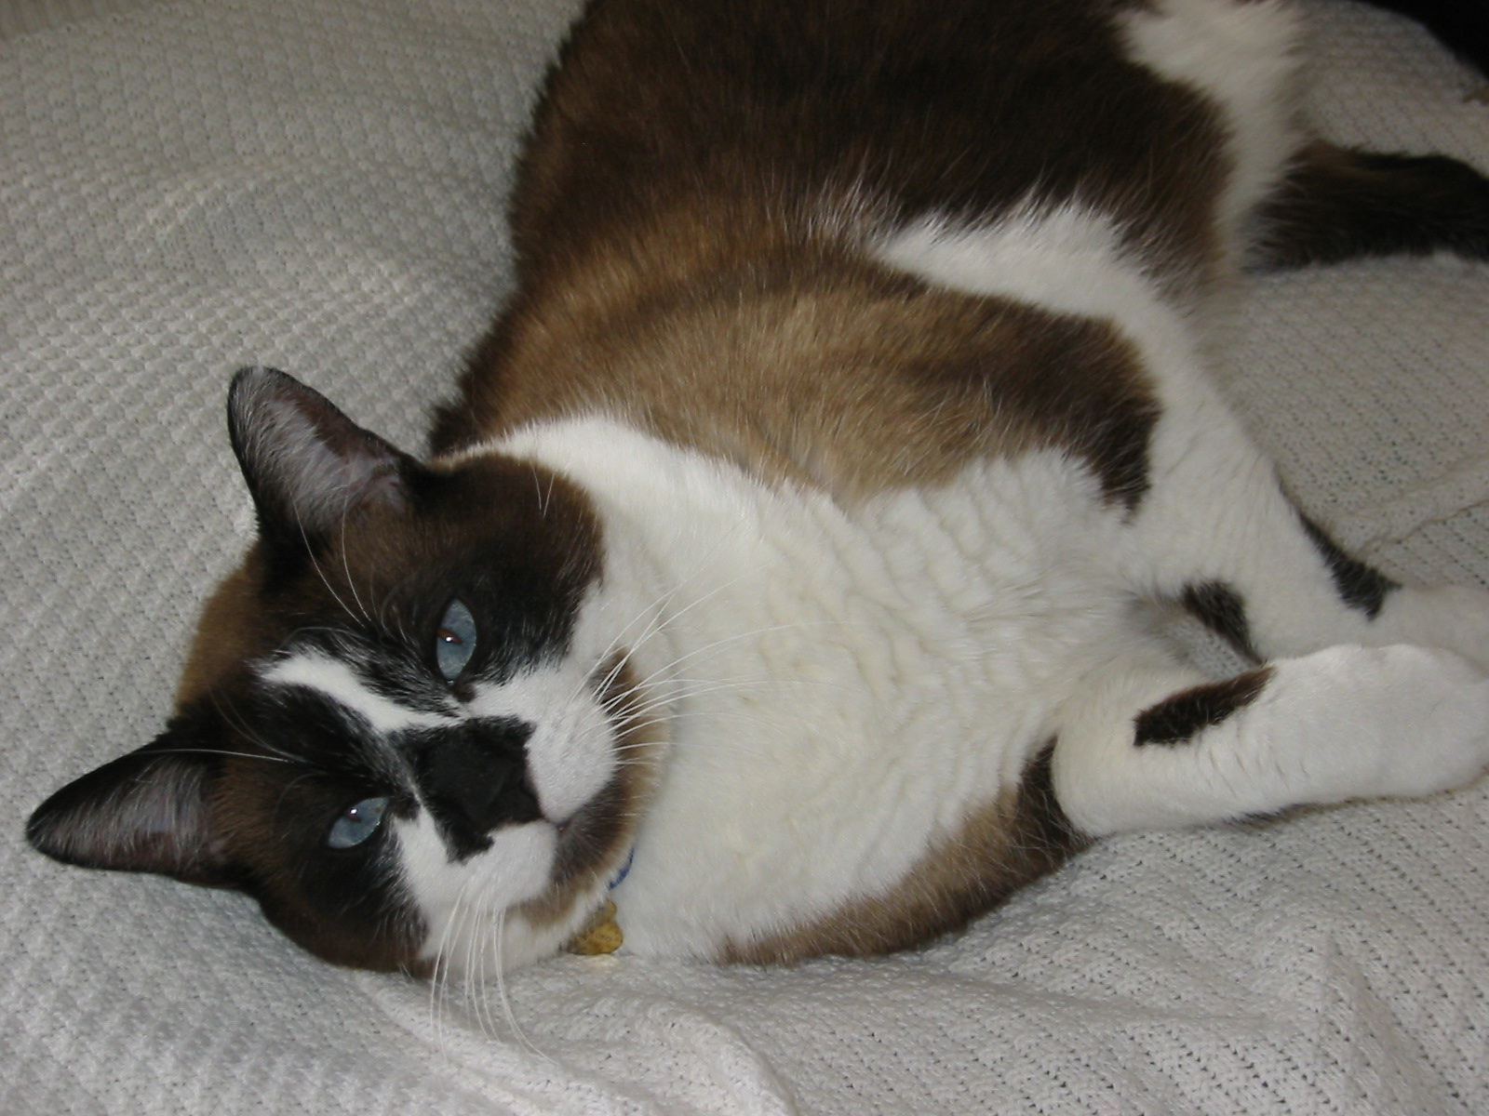
Nice Kitty?

Slide 18
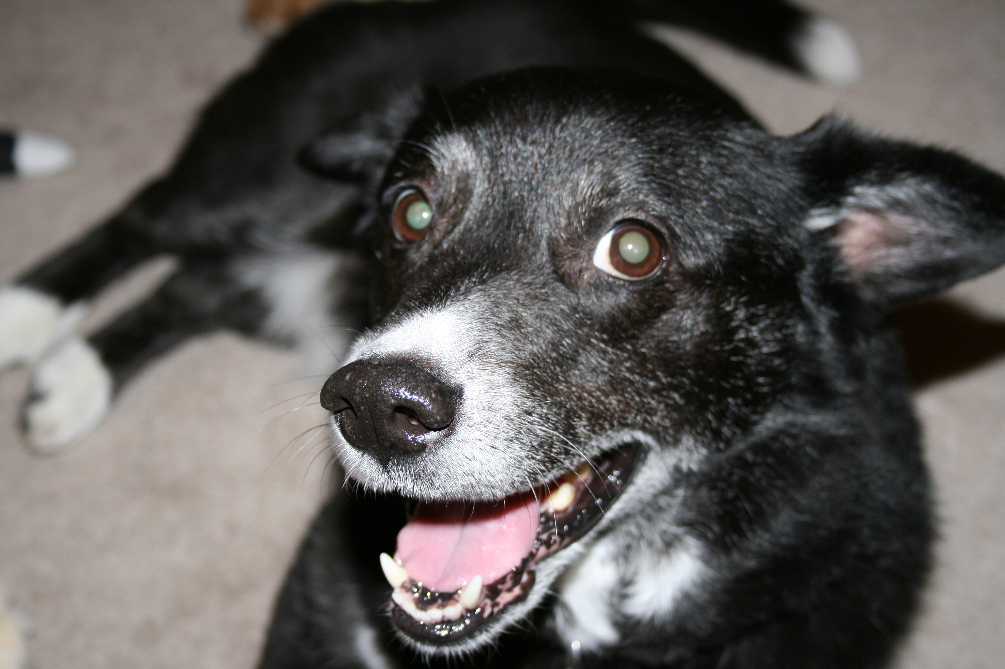
Medical Therapy and Behavioral Modification
Urinary tract infections
House training
Litter box training
Weight Loss
Controlled walking
Cage Rest
Crate training
Mental stimulation

Slide 19
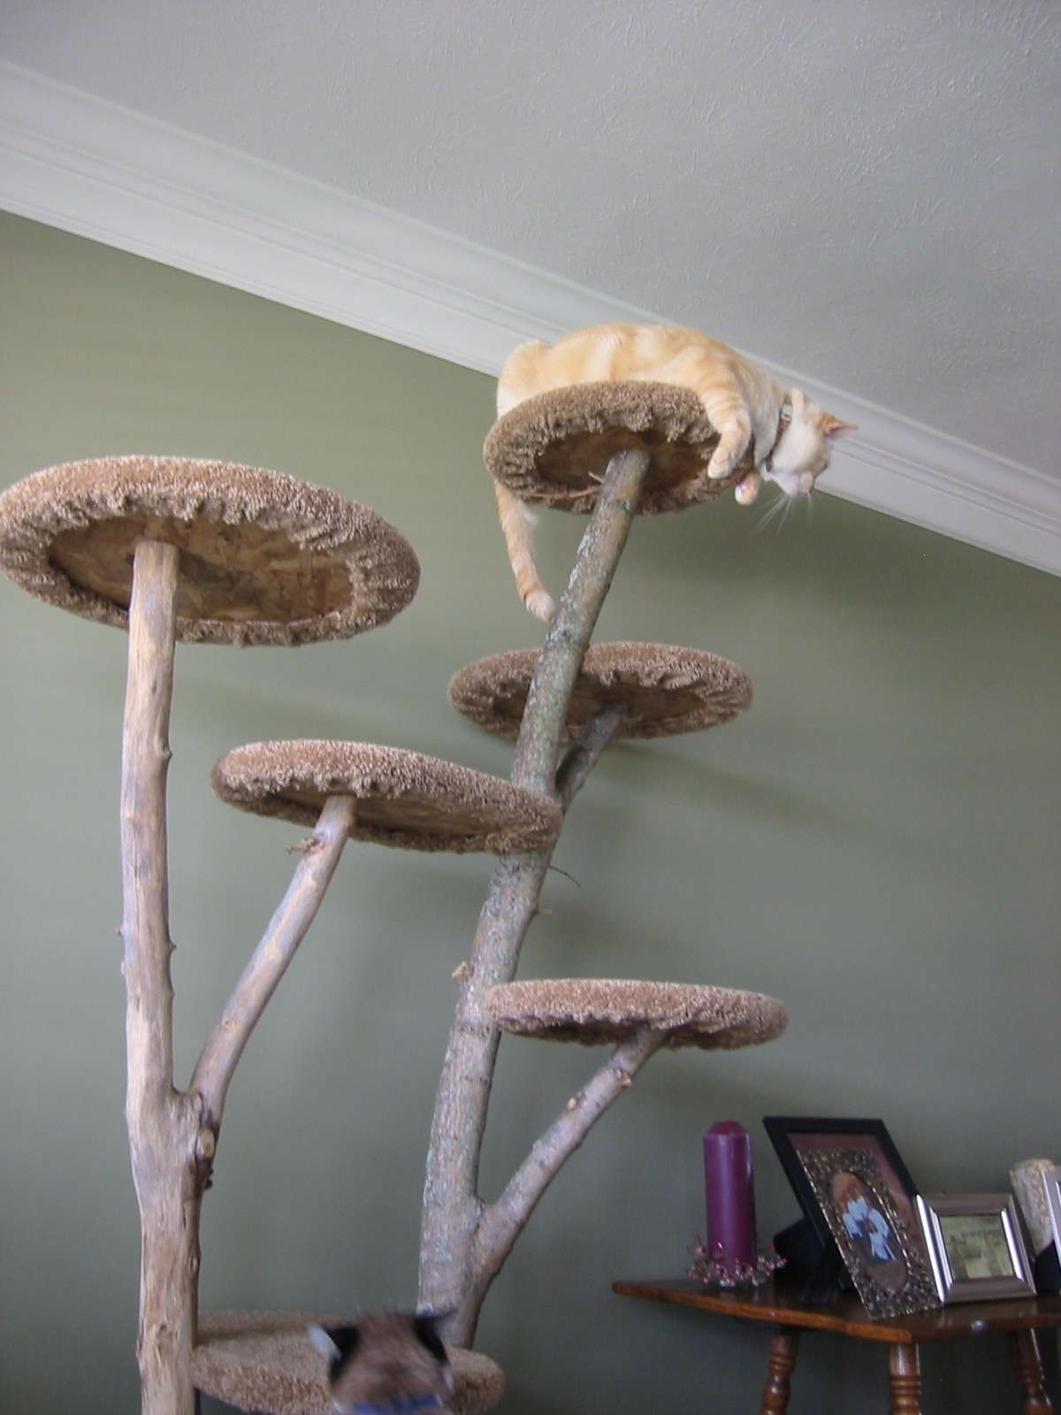
Feline Lower Urinary Tract Disease
Stress is a significant factor
Environmental Therapy
Client education:
Litter box management
Stress reduction:
Activity
Feliway
Core Areas/Safety Zones
Amitriptyline?
www.vet.ohio-state.edu/indoorcat

Slide 20
Reasons to include behavior in your practice:
Keep patients in the practice
Increase the quality of medicine delivered
Attract new clients
Increase client esteem for practice
Keep staff happy
Bond clients to the practice
Bond pets to the practice
Have well behaved patients
Increase the life expectancy of your patients
Increase the number of pets owned by the average client
Rolan Tripp, DVM

Slide 21
How do I learn more about behavior?
Linda Case
Behavior Club
Veterinary Conferences
Puppy works –www.puppyworks.com
Purdue
Read
Volunteer
CCHS
Blood donor dogs
Training class

Slide 22
Resources
The Culture Clash by Jean Donaldson
Don’t Shoot the Dog by Karen Pryor
The Other End of the Leash by Patricia McConnell
Dog Language by Roger Abrantes
I’ll be Home Soon by Patricia McConnell
Fastidious Feline by Patricia McConnell
Way to Go by Patricia McConnell
Before and After You Get Your Puppy by Ian Dunbar
Handbook of Behavioral Problems of the Dog and Cat by Gary Landsberg

Slide 23
Large Animals
Sorry
Temple Grandin
Safety, Safety, Safety!!!!!!!!
Large Animal Clinic

Slide 24
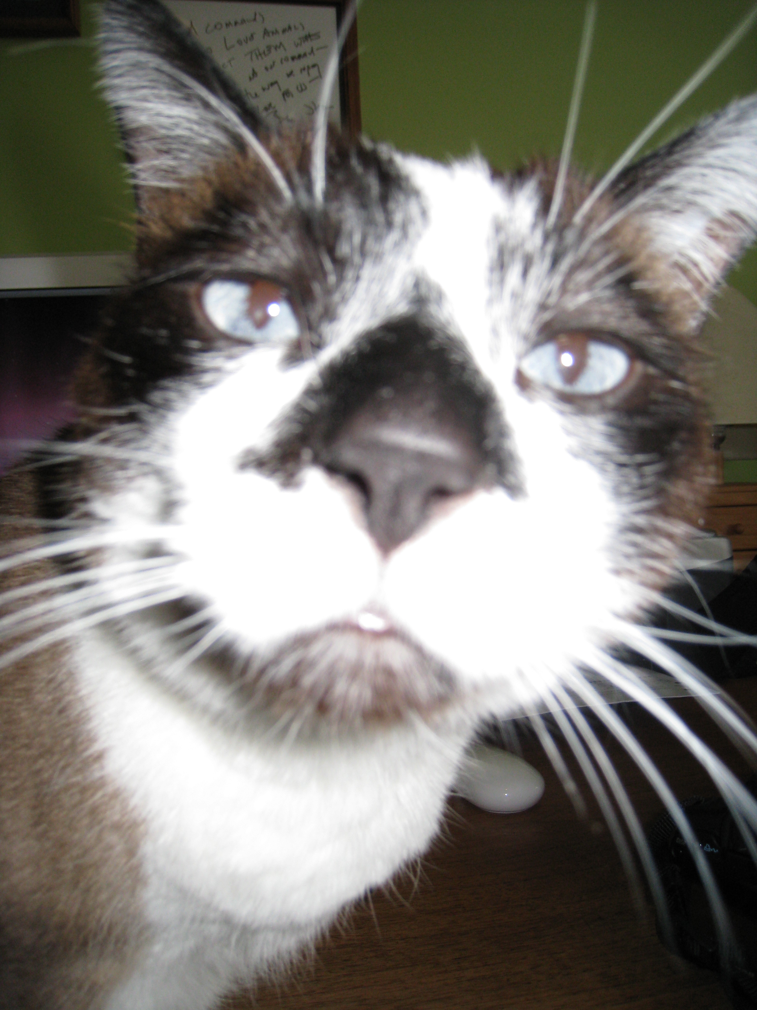
Questions?

